Slide 1
DAY 3
Technical communication

Slide 2
Types of Audience
EXPERTS
TECHNICIANS
NON-SPECIALIST
EXECUTIVES

Slide 3
Audience Adaptation
Information Acquisition
Omit information you do not need
Information modification (as per the level)
Understanding multiculturalism
Add cross - references (important information)
Consolidate text (break text up) into meaningful and useful portion
Utilization of Graphics
Subheadings
Strengthen Transitions
Structure

Slide 4
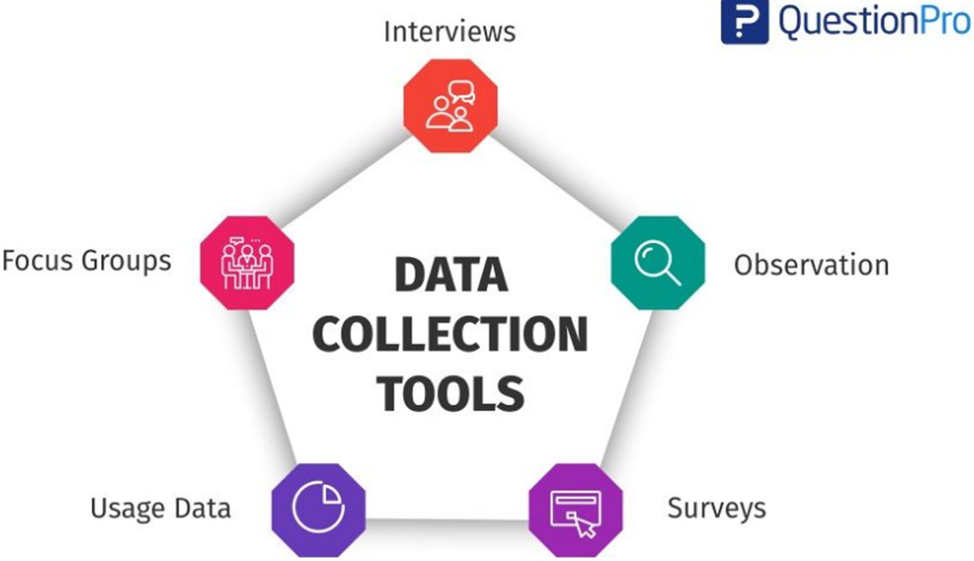
Research tools

Slide 5
Conducting SME Interviews
Define a Topic and Time Limit. Set Expectations. Prepare Yourself. Question Your Questions. Prepare Your SME [subject matter expert (SME) interviews allow you to learn about your topic from the people who know it best] Get On With It. Summarize and Clarify. Ask for Parting Thoughts.

Slide 6
Validations
Technical / Scientific Justification. Compliance With Regulations. Document Quality.

Slide 7
Tips for collecting information from SMEs
Focused:
The information targets one task, problem, or topic.
You should present information in short chunks, which the learner can put to immediate use.
Relevant:
Information should be relevant to the audience and the tasks they need to perform.
It should also fulfill a just-in-time need.

Slide 8
Engaging:
Content-rich learning brings facts to life with stories, examples, and scenarios.
Deep:
Finally, content-rich learning is detailed.
It embodies the SME’s tacit knowledge, which is based on observation and experience.

Slide 9
